Slide 1



Aarogya@home
WIT Hackathon submission

Slide 2
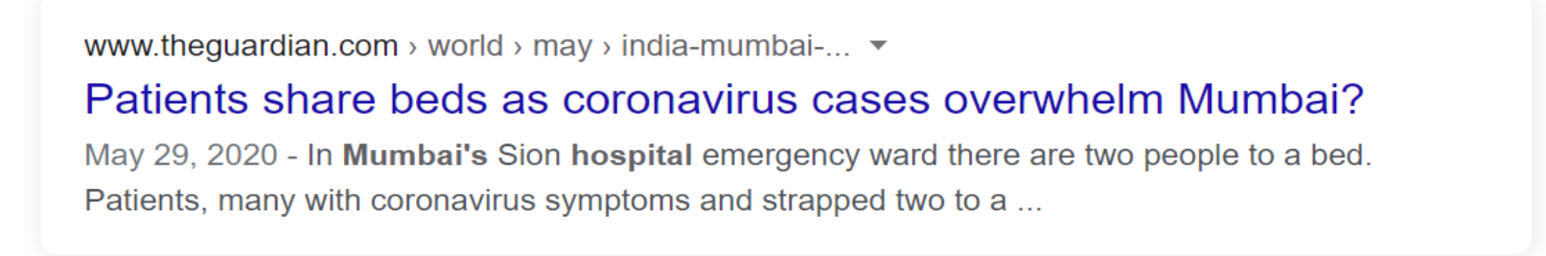
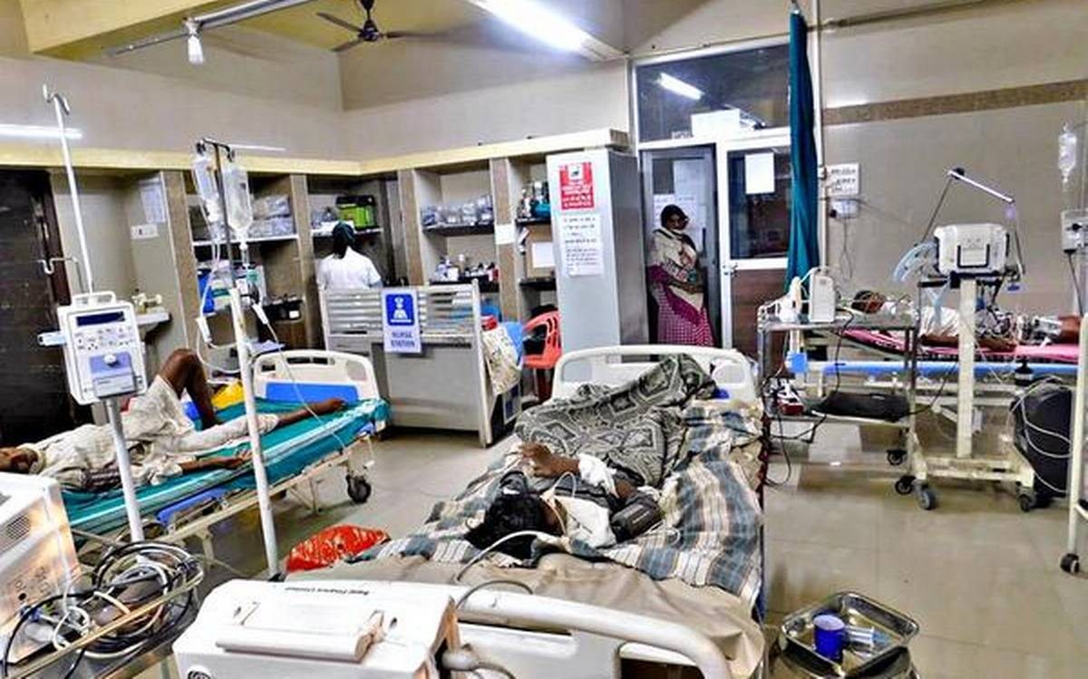
Overwhelmed hospitals
Patients dying without treatment
People lost income opportunities

Slide 3




Reduce load from hospitals
Recover at the comfort of home
New business ecosystem

Slide 4







Aarogya@home supplier
ecosystem
Aarogya@home
mobile app

Slide 5





Roadmap
Recommendation for best offers based on
requirement.
Patient
Recommendation for self-quarantine
Cloud based aggregation platform
Central database on cloud
API wrapper on the business logic layer on cloud
Web portal for the suppliers
Notification capability
Identity and access management functions
API integration
Mobile app -built on Android Studio & in-built SQL lite DB
IBM Watson
Aarogya@Home user interaction via Mobile-app

Slide 6
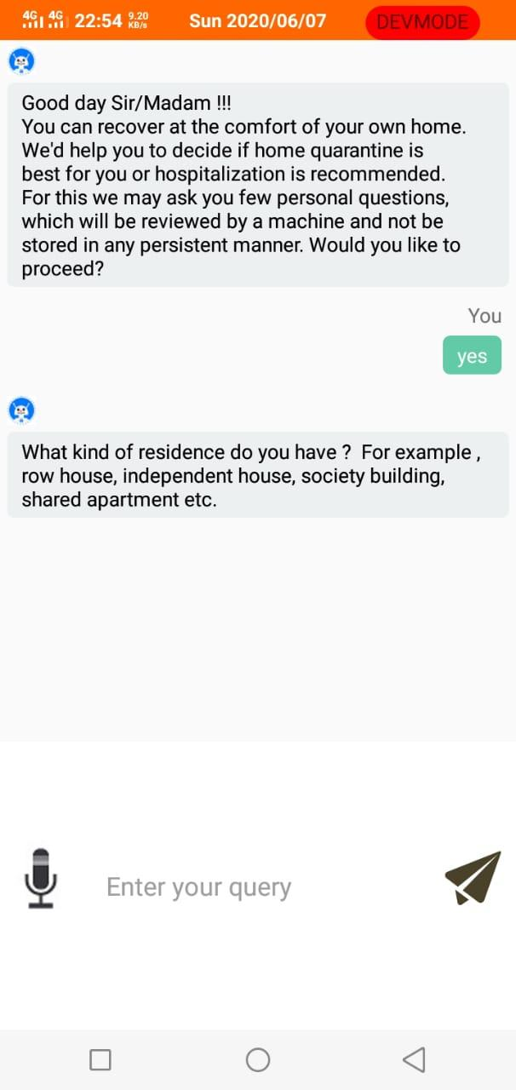
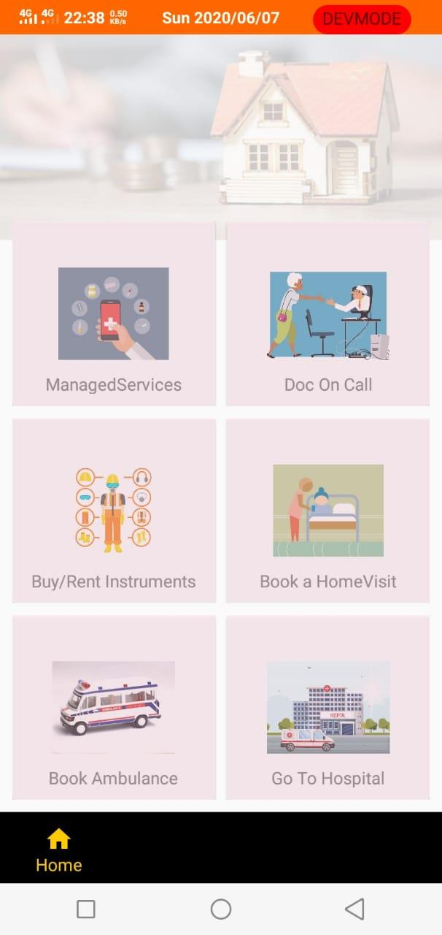
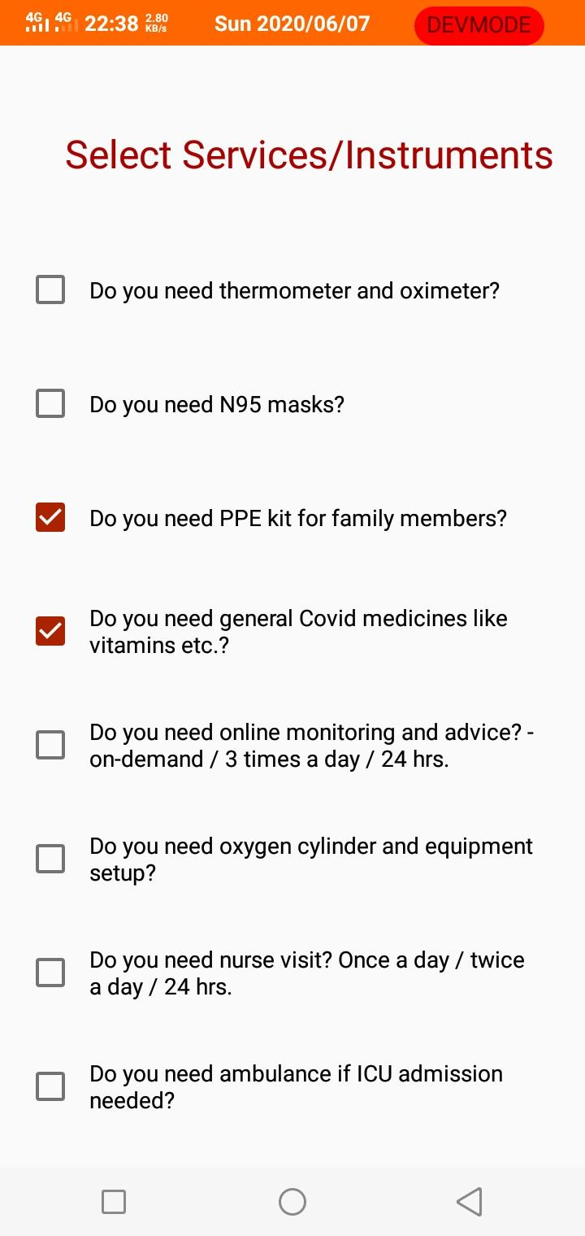
Questions to capture customer’s intent and accordingly prioritize relevant products listing.
Suitability check for home-quarantine
Easy categorization of products and services on the Home screen.

Slide 7
Thank You

